Slide 1
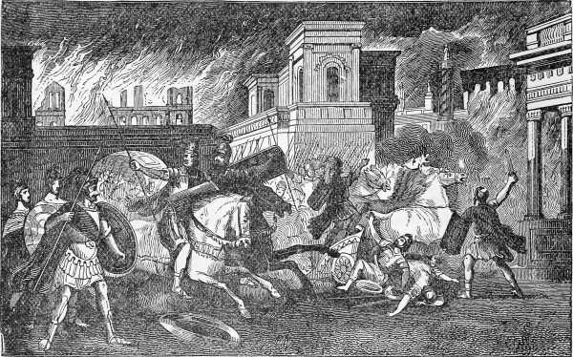
Ezekiel 16-19
Justification for the destruction of Jerusalem continues…
And an appeal to personal responsibility….

Slide 2
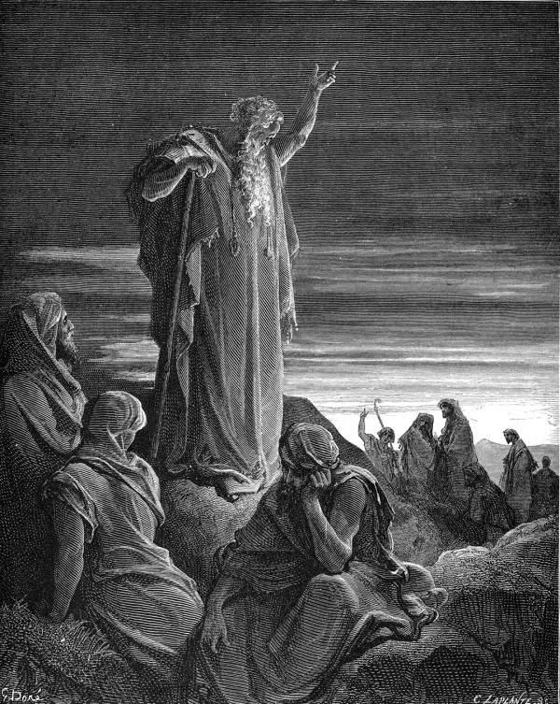
Ezekiel 16: Apostasy Parables
Ezekiel makes known to Jerusalem her sins. In these parables Jerusalem is compared to an unfaithful wife and a fallen sister.
Parable of the Unfaithful Wife (16:3-43)
Parable of the Three Sisters (16:44-63)

Slide 3
Ezekiel 16: The Unfaithful Wife
Parable of the Unfaithful Wife (16:3-43)
The Unwanted Child (16:3-6)
The Beautiful Marriage (16:7-9)
The Adornment of the Bride (16:10-14)
The Infidelity of the Bride (16:15-34)
Trusted in herself
Played the harlot with idols
Made high places and idols
Sacrificed sons and daughters to idols
Not grateful to God “did not remember” (v. 22)
Played the harlot with other nations
“No one plays the harlot like you do…” (v. 34)
The Punishment of the Bride/Harlot (16:35-43)
Repetition Alert!
God saying “I”, “My”
Emphasizing all He had done for Jerusalem.

Slide 4
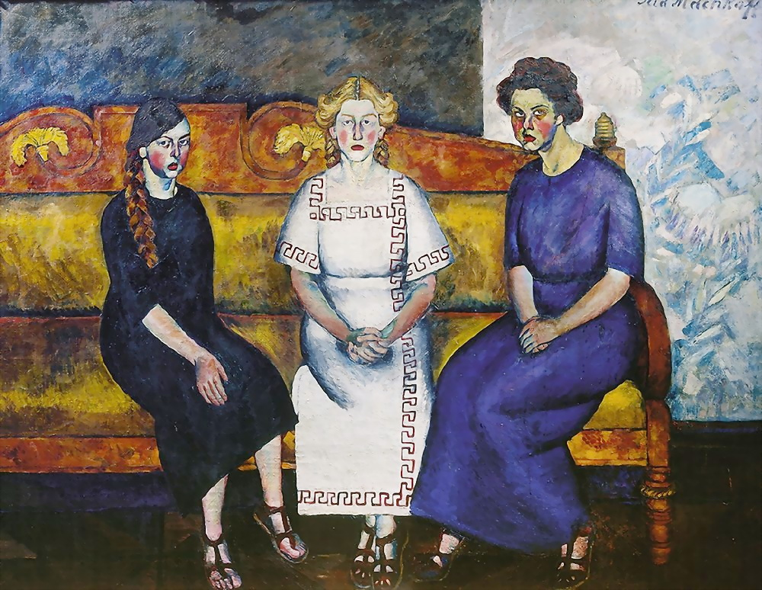
Ezekiel 16: The Three Sisters
“Like Mother, Like Daughter…”
Parable of the Three Sisters (16:44-63)
The Record of the Sisters (16:48-52)
The Future of the Sisters (16:53-63)
Punishment
Hope
“So that you will remember and be ashamed…” (16:63)

Slide 5
Ezekiel 17: Political Parables
Ezekiel compares the royal family to a cedar tree in “Lebanon”, a symbolic name for Jerusalem. In this chapter the past, present and future of the Davidic line is discussed.
Parable of the Eagles (17:3-21)
Parable of the Stately Cedar (17:22-24)

Slide 6
Ezekiel 18: Personal Responsibility
Rather than repentance, the people of Judah responded to the preaching of His prophets with sayings and proverbs. God refutes one of these proverbs and teaches about personal responsibility and free will.
The Teaching of Personal Responsibility (18:4-20)
The Fate of a Righteous Man (18:5-9)
The Fate of the Wicked Son (18:10-13)
The Fate of the Righteous Son (18:14-18)
The Teaching of Free Will (18:21-32)

Slide 7
Ezekiel 19: Lamentation Parables
Two parables: Lamentations over the recent, foolish Kings of Judah.
Parable of the Lion Cubs (19:1-9)
The First Cub (19:1-4)
See Jeremiah 22:10-12. Who was this cub?
Shallum aka Jehoahaz
The Second Cub (19:5-9)
See 2 Chron. 36:5-10. Who was this cub?
Jehoiakim and Jehoiachin
The Parable of the Vine (19:10-14)
Rulers, destruction, exile, no king.

